Slide 1
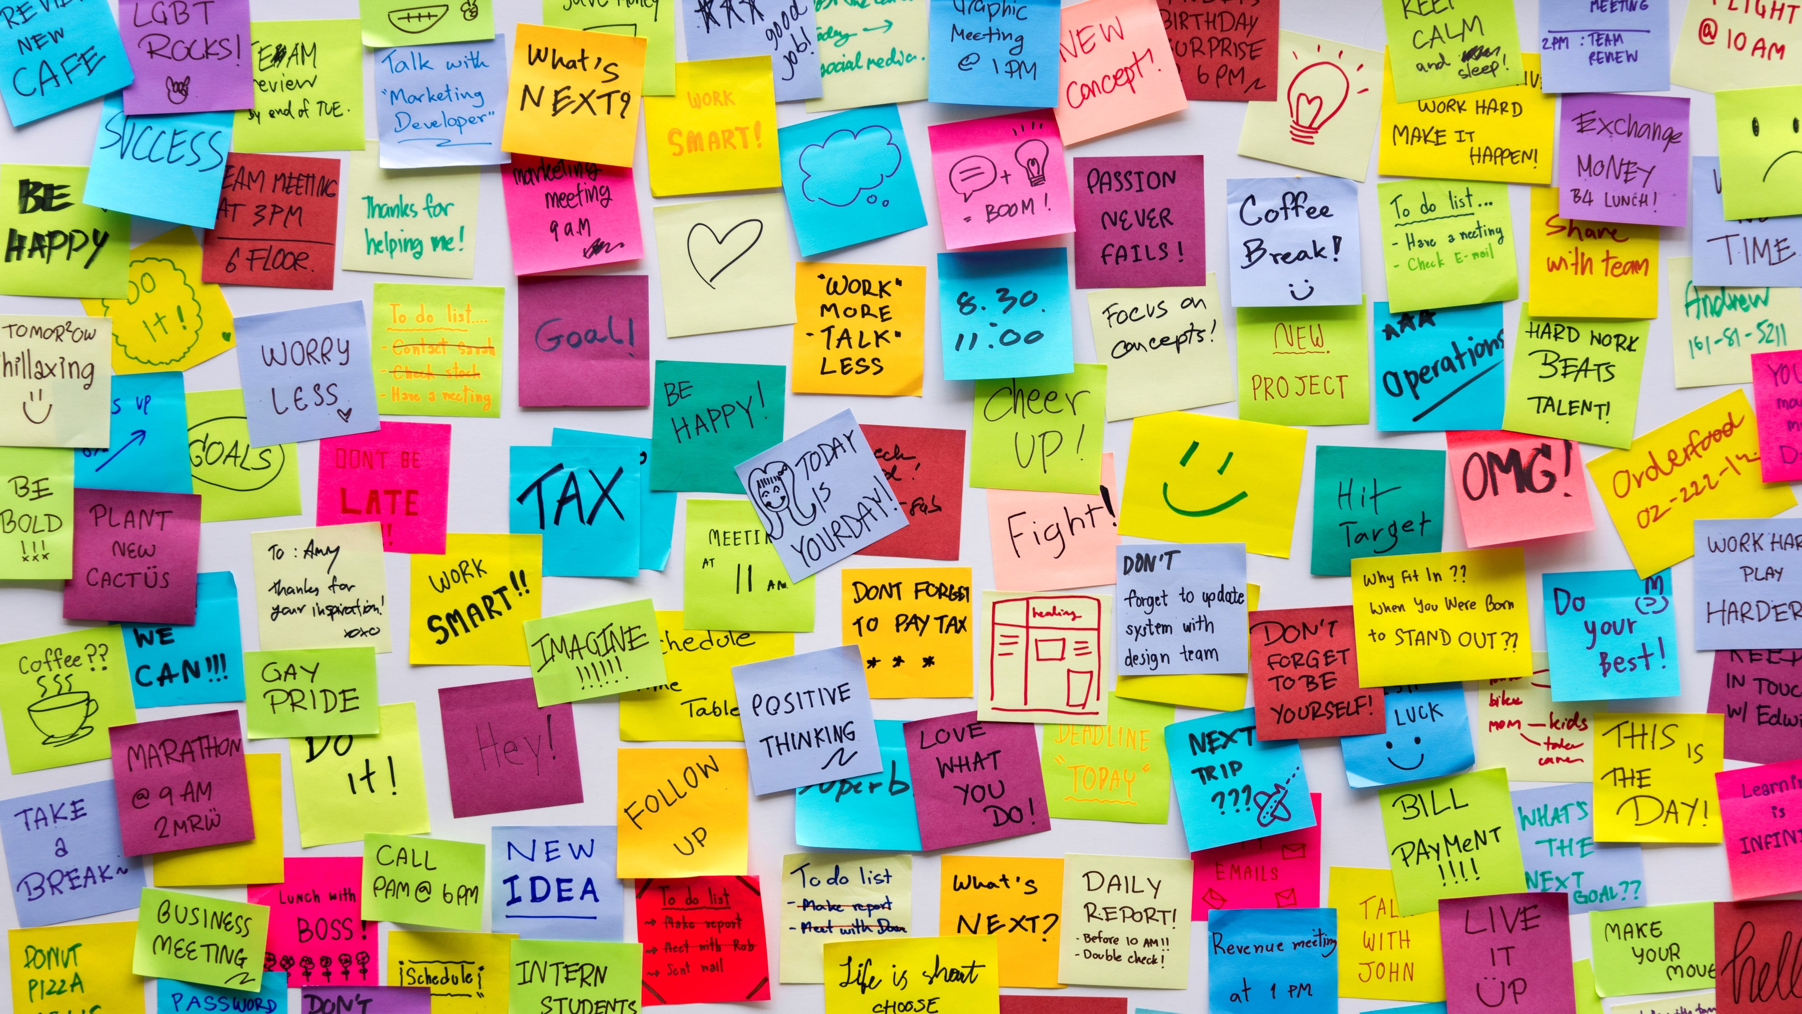
Hand Printed Names Recognition
By Edward De Jesus

Slide 2


Agenda
OCR
Datasets
Machine learning models performance
Character segmentation and prediction on Names Dataset
Next Steps
Web app

Slide 3
Optical Character Recognition (OCR)
Rise of machine learning and higher processing power.
Challenges of Handwritten text
Using Machine learning for OCR

Slide 4
The U.S. Library of Congress holds approximately sixty million manuscripts, which are documents written by hand rather than typed or printed. Improving handwritten text recognition using machine learning can help with searchability, readability and accessibility of these documents.

Slide 5
Datasets
Handwritten Characters
Handwritten Names
All lower- and upper-case English alphabet characters
Digits 0-9
Other Characters @, #, $, &
39 Classes
834,036 training samples, 22,524 validation samples
206,799 first names and 207,024 surnames

Slide 6
Machine Learning Models Performance
Model | Description | Validation set loss | Validation set accuracy
KNN Model | 1 Neighbor | -- | 93.55%
CNN Model 1 | 4 layers, 163, 367 parameters | 0.1826 | 94.62%
CNN Model 2 | 7 layers, 345,959 parameters | 0.0864 | 97.19%

Slide 7
Machine Learning Models
Convolutional Neural Net
Con2D
Con2D
Con2D
Con2d
Con2D
Con2D
Con2D
Flatten
Dense – 39 Classes output
Batch Normalization
Batch Normalization
Batch Normalization
Dropout
Batch Normalization
Batch Normalization
Batch Normalization
Dropout
Batch Normalization
Dropout
Input

Slide 8

Hand Printed Names Recognition
Name Recognition Steps
Open CV object detection
Sort left-to-right
Format to 32x32
Predict single characters using trained CNN model
Join predicted letters
C
L
A
R
A
CLARA

Slide 9
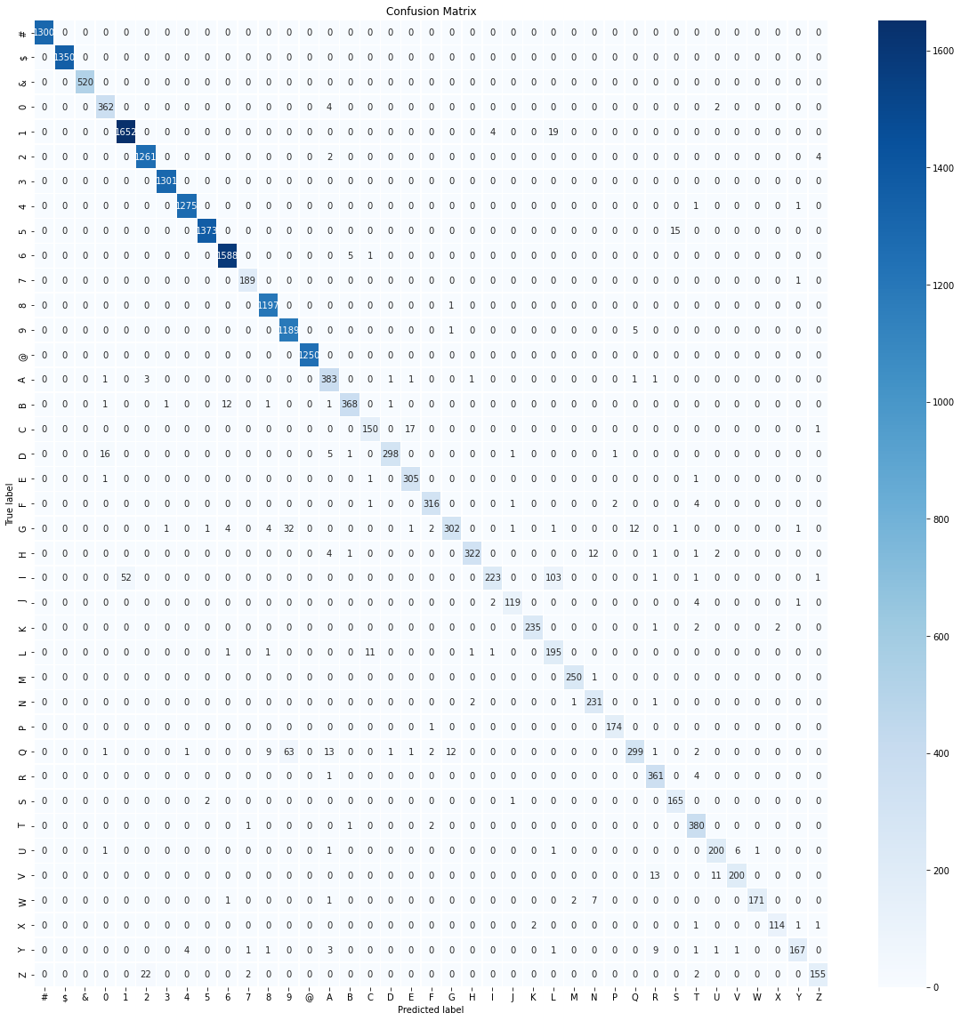






Model Evaluation
Name | Transcription
 | CLARA
 | JENNIFER
 | MICHHEL
 | 6E0R6E
 | E175A
 | TH0MA5

Slide 10
Next Steps
Use dictionary of names to improve accuracy
Transcribe larger documents
Transcribe script writings

Slide 11
Webb App
Hand Printed Text Image Transcriber

Slide 12
Thank You

